Slide 2
Introduction (general background, several limitations)
One outline figure to present the thesis components.
Not to address all limitations but some focus
Four papers
Quick recap of the project motivation
Results
Take-away messages
Impacts? Applications?
Acknowledge
Funding logos?
Backup: Future direction? Limitions?

Slide 3
Questions
1. Know your examiners [5 key words about their studies]
2. Know all your works
3. Know some basic of your research filed and future directions.

Slide 4
1. Please add slide numbers. 2. No need to introduce from Stone Age techniques such as Sanger sequencing etc. Just start with the modern repositories. 3. The flow of introducing Chen’s paper on disentanglement is not right. You may introduce that after talking about sTF and trans papers (still within your Introduction part). It is inconsistent to sTF and trans projects, but unlocks the next two projects IMAS and rv. 4. Put Lilit’s name on the page where you mention Paul Arnold. It is not good to just generally refer to “group members”. 5. Forgot whether you have cited your papers/manuscripts at the corner of the slides. Please add if haven’t. Finally we need a better group picture!

Slide 5
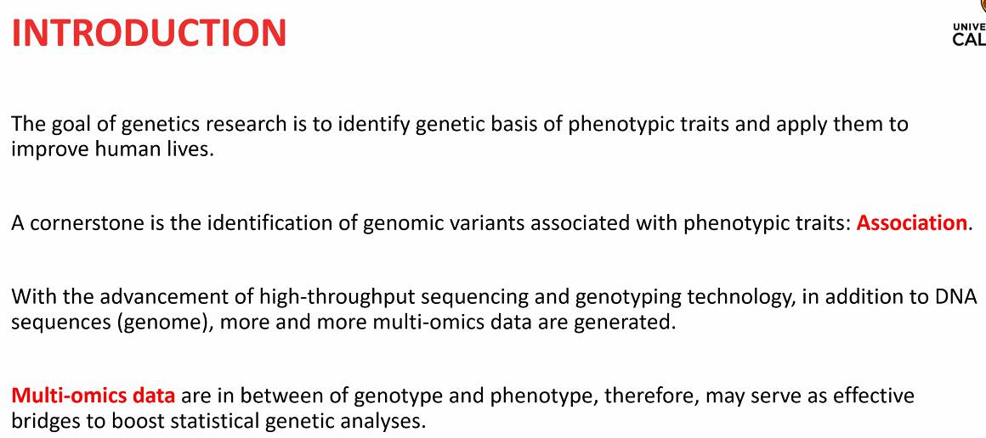

Slide 6
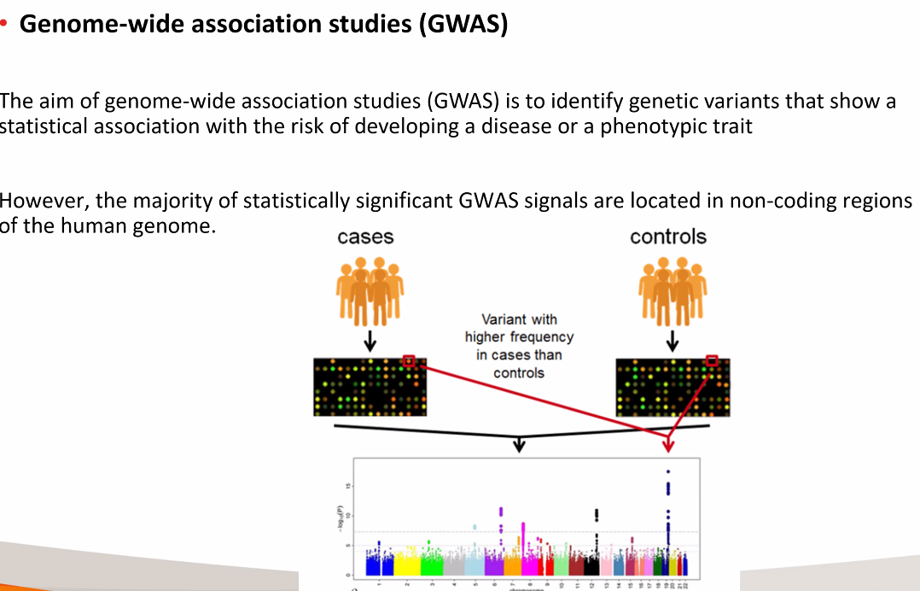

Slide 7
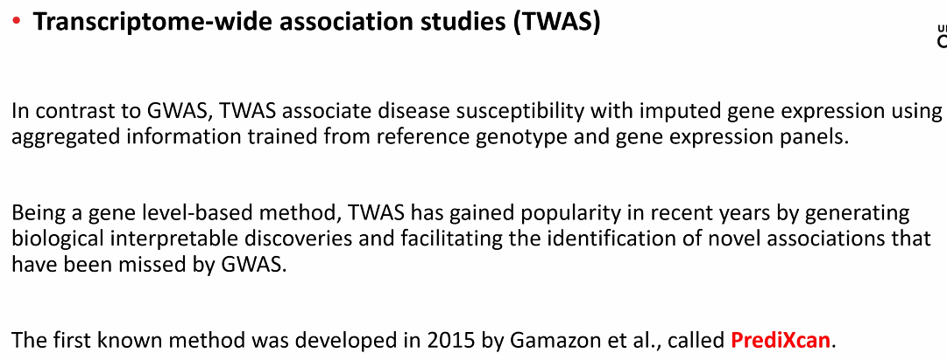

Slide 8
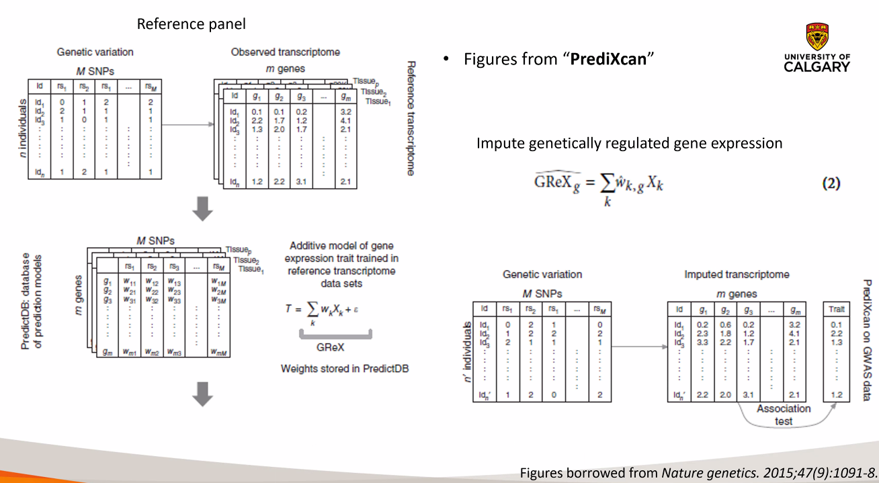

Slide 9
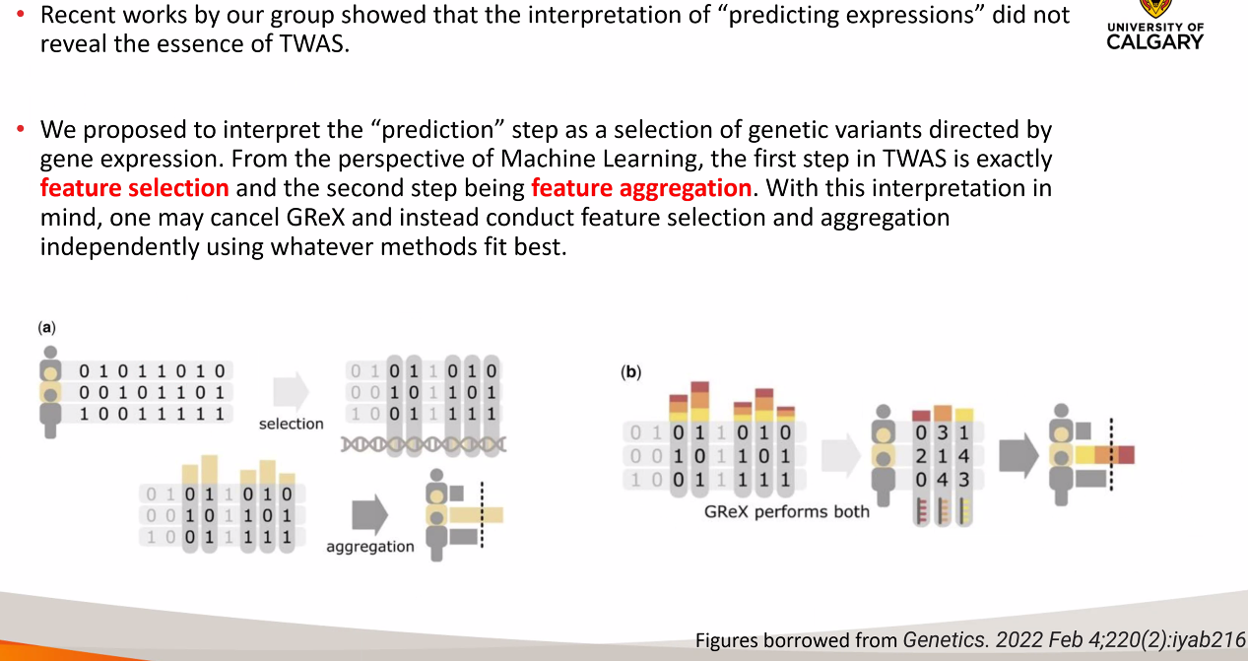

Slide 10
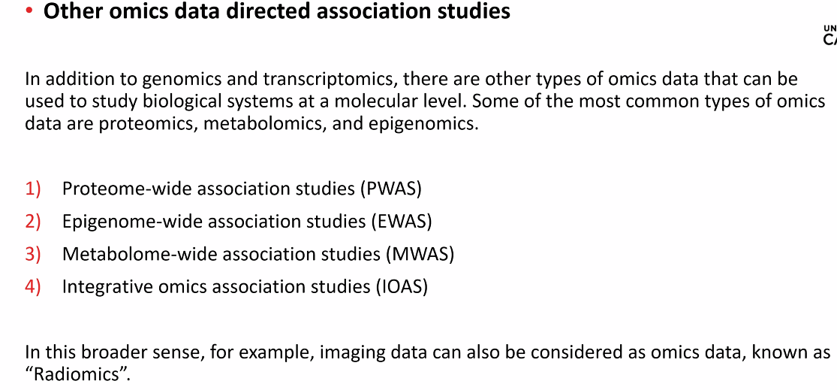

Slide 11
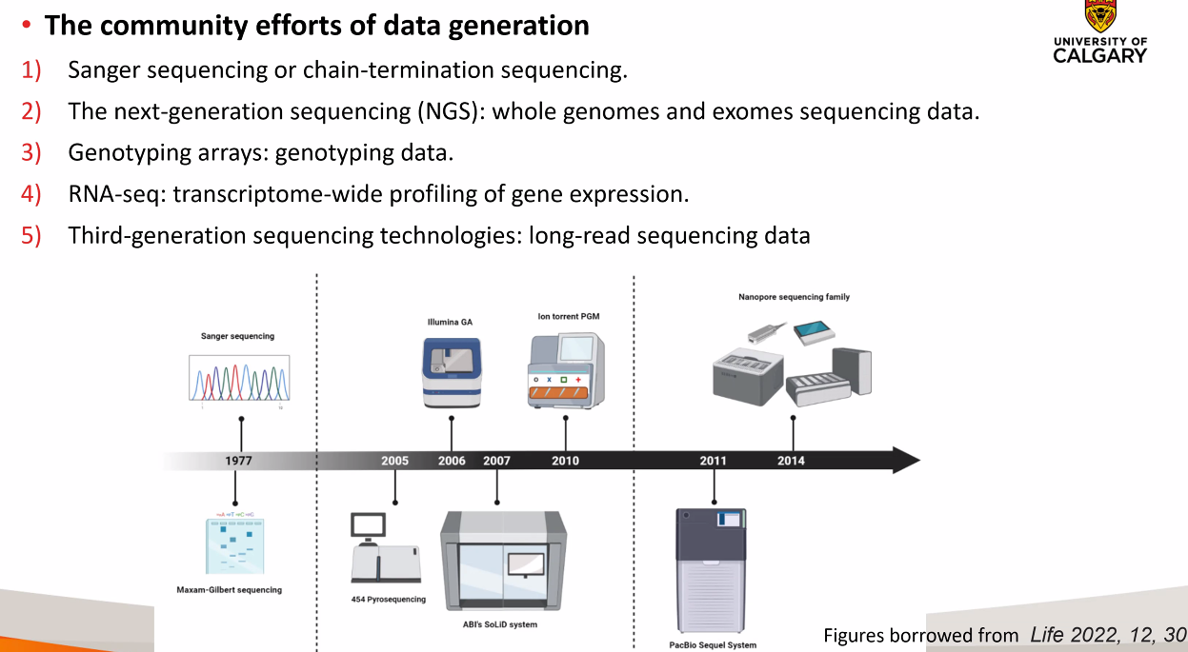

Slide 12
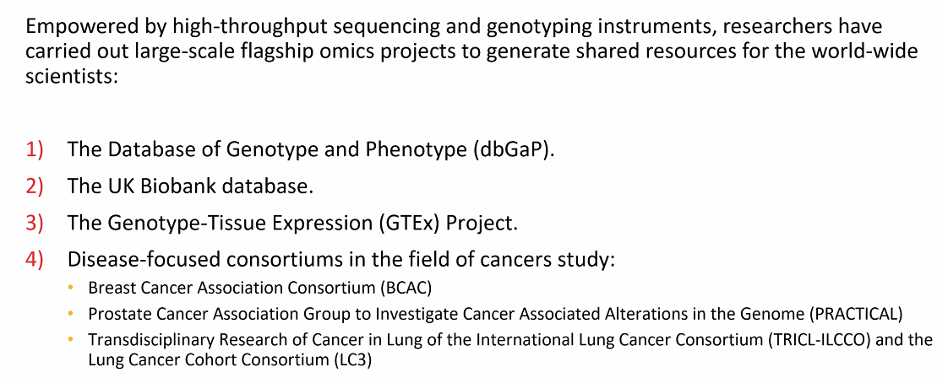

Slide 13
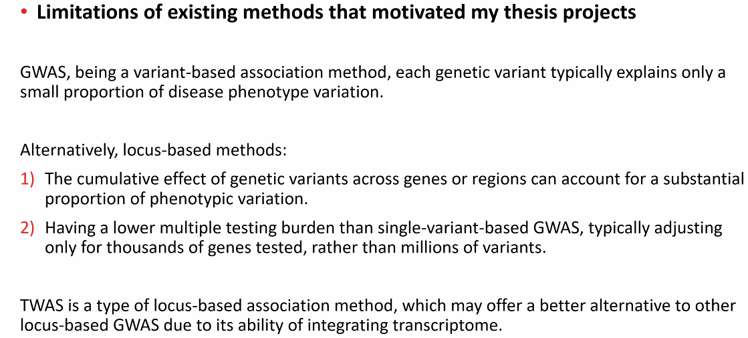

Slide 14
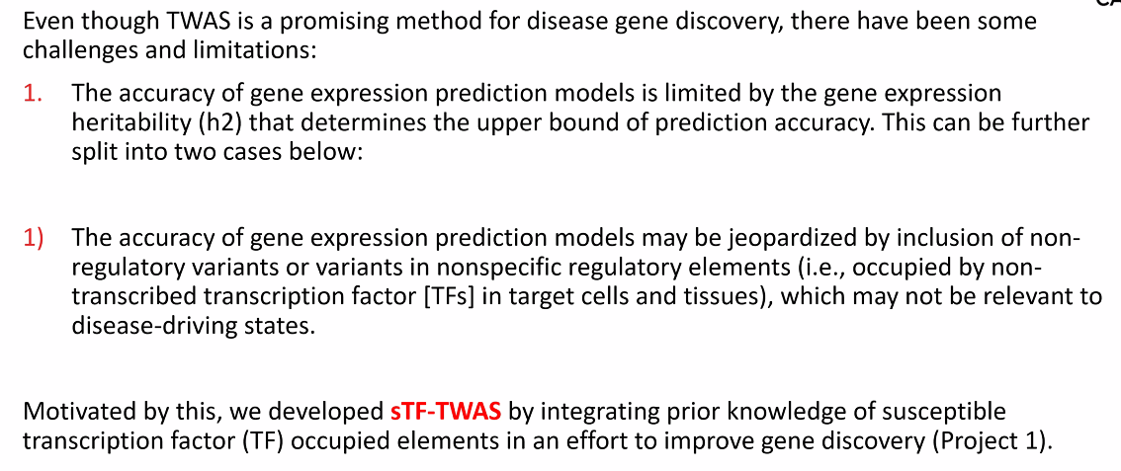

Slide 15
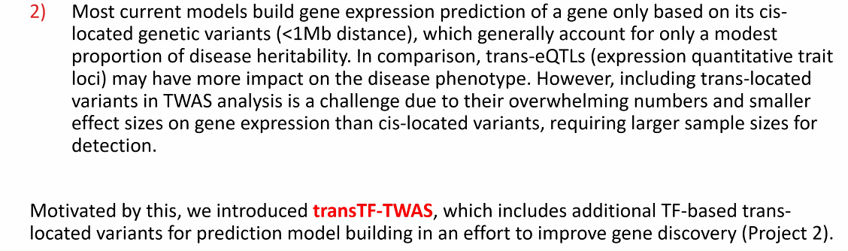

Slide 16
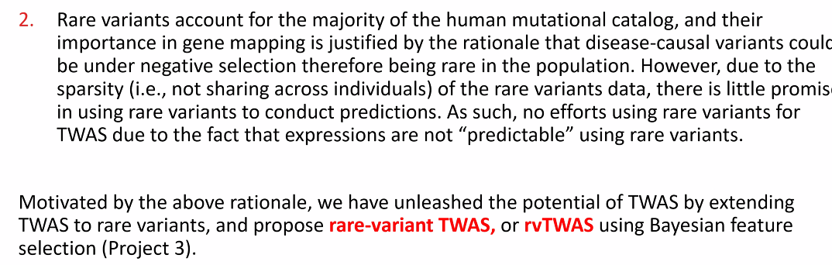

Slide 17
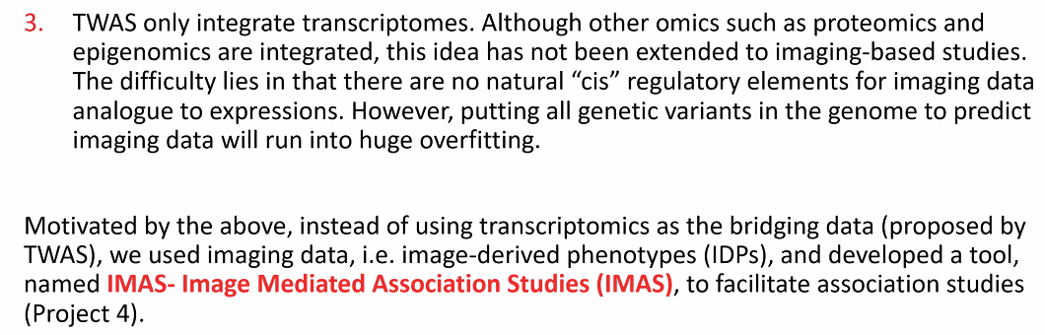

Slide 18
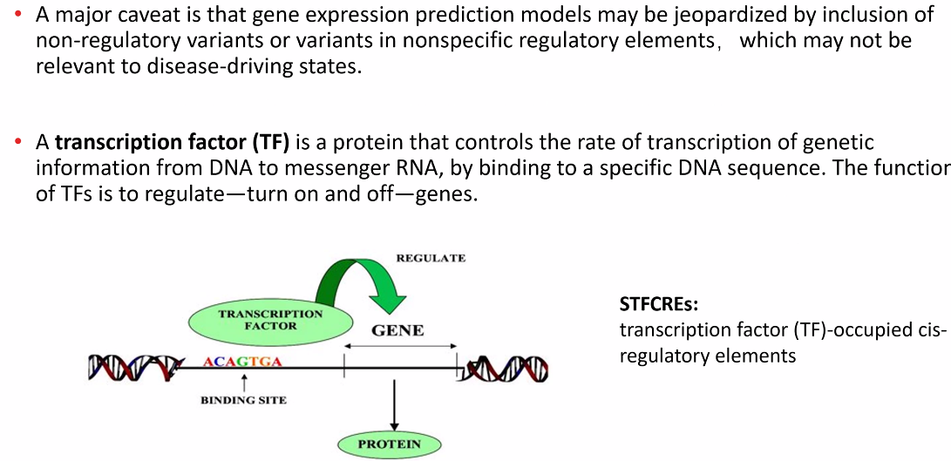
Project1

Slide 19
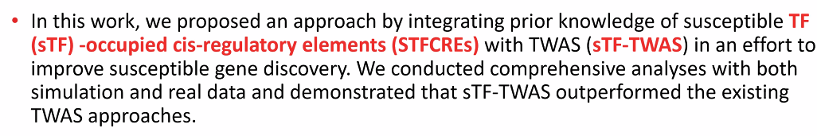

Slide 20
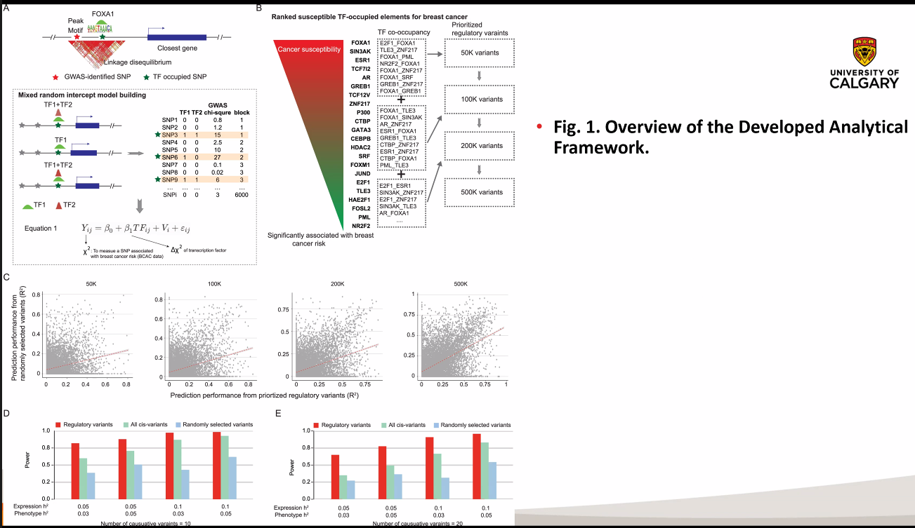

Slide 21
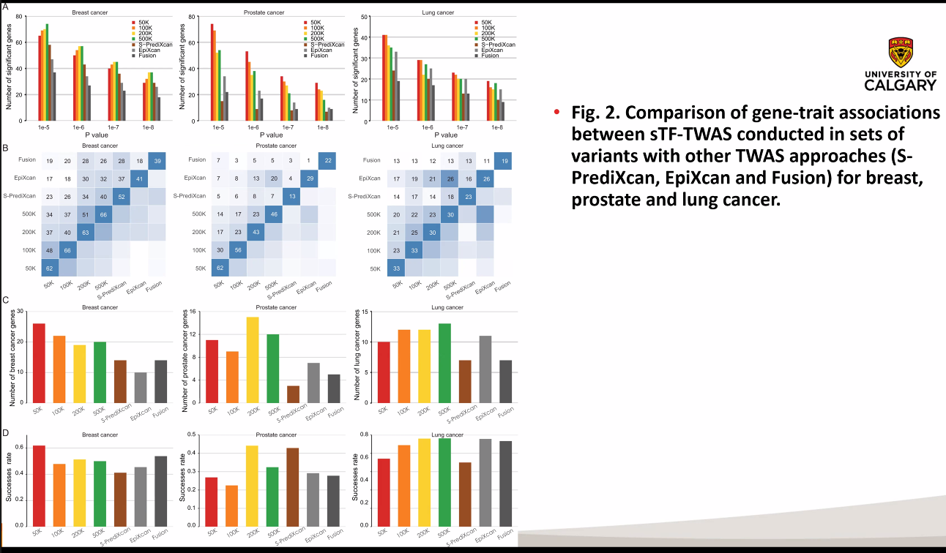

Slide 22
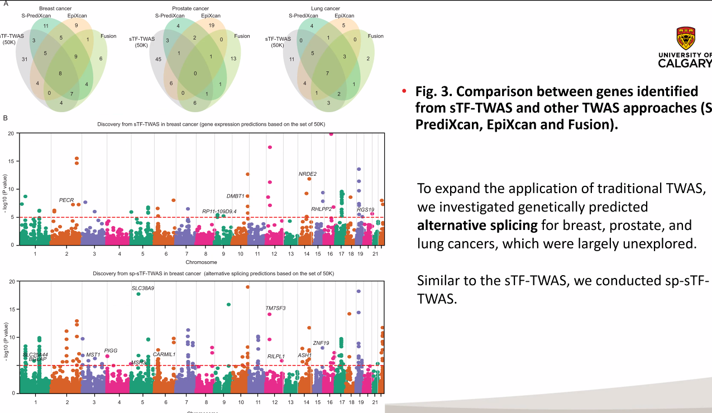

Slide 23
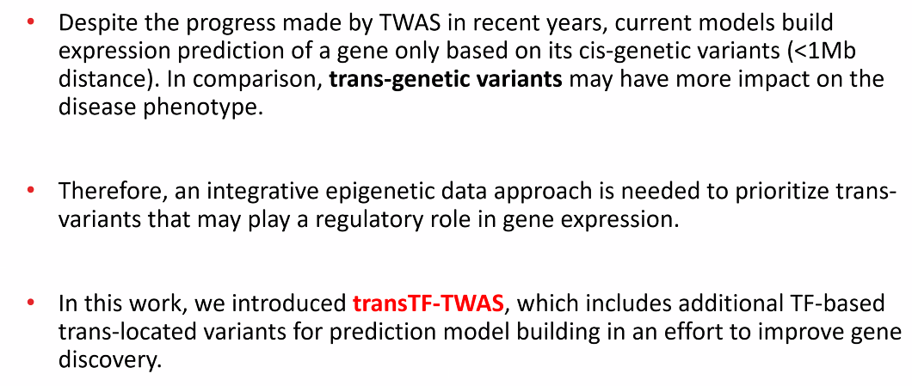
Project 2

Slide 24
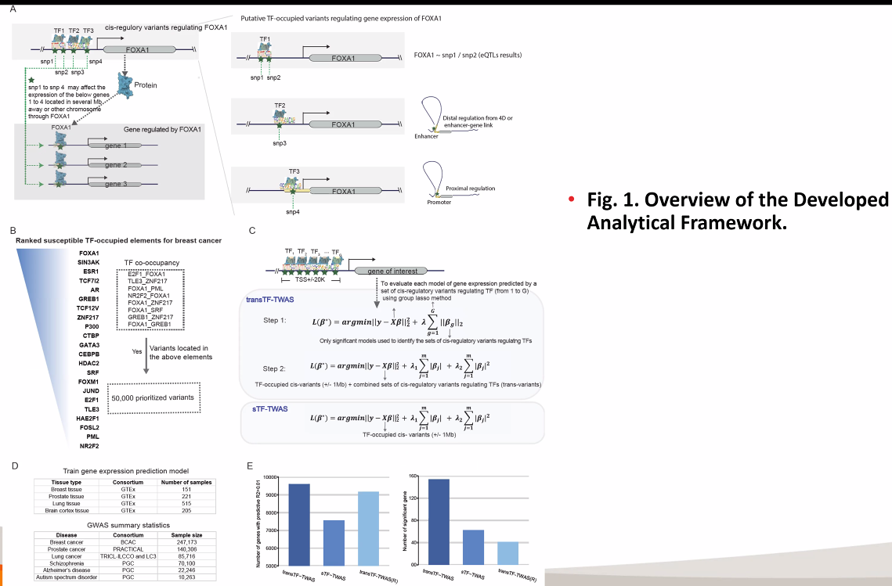

Slide 25
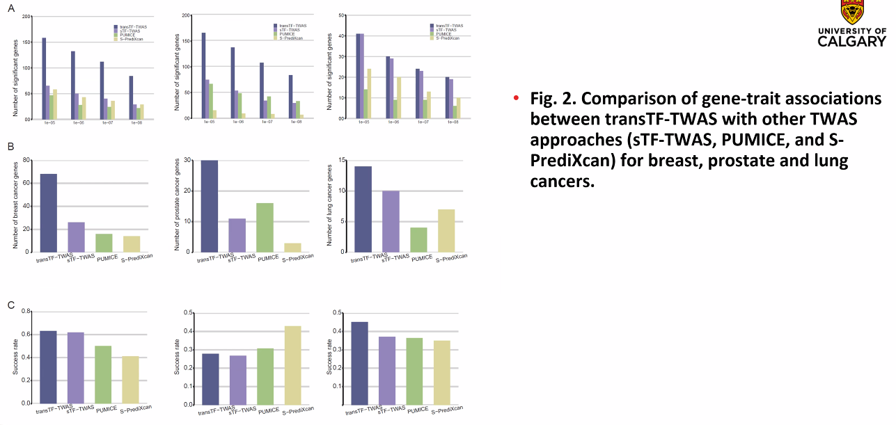

Slide 26
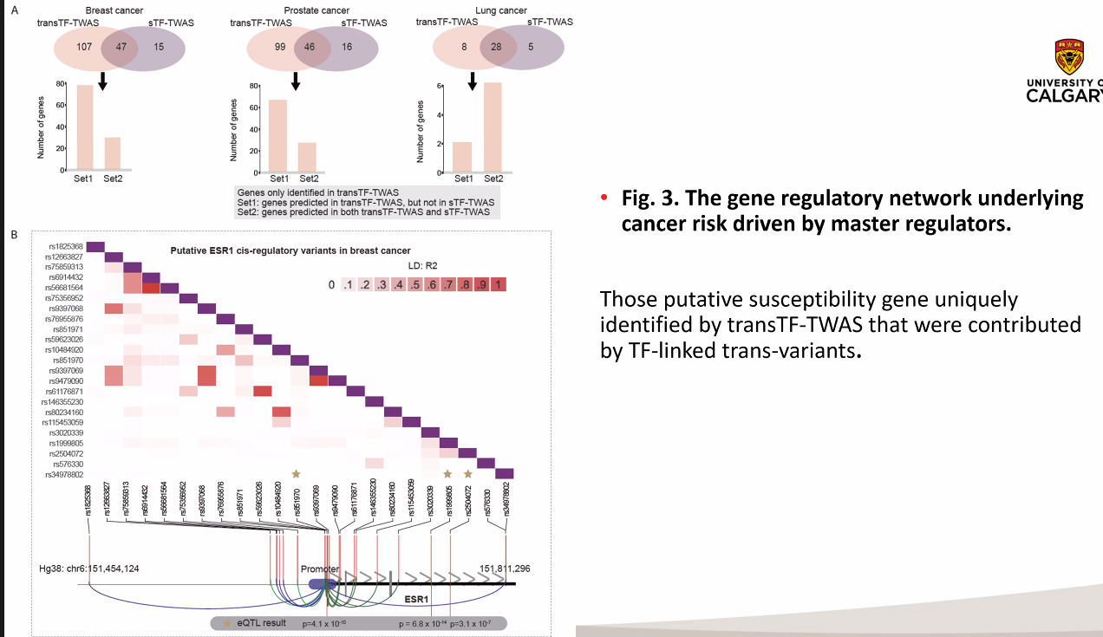

Slide 27
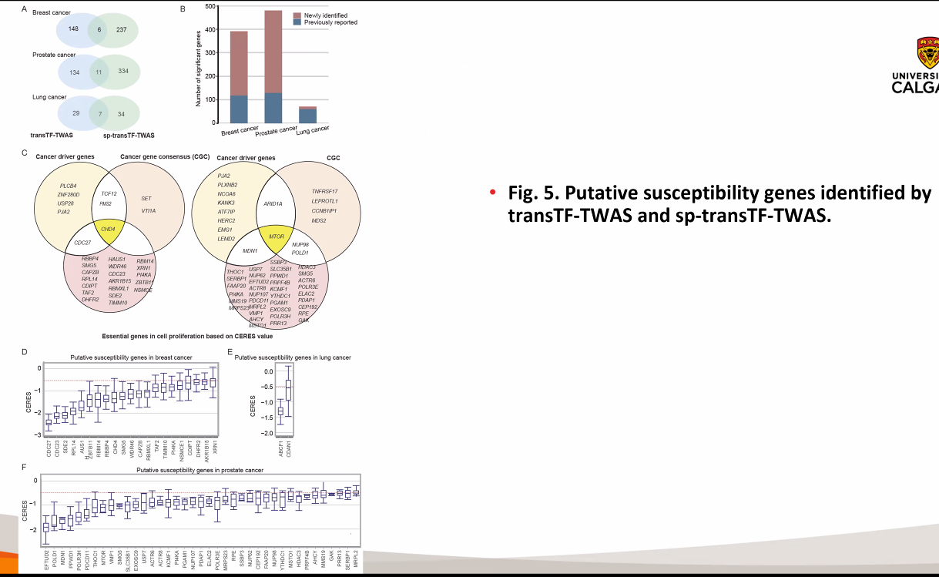

Slide 28
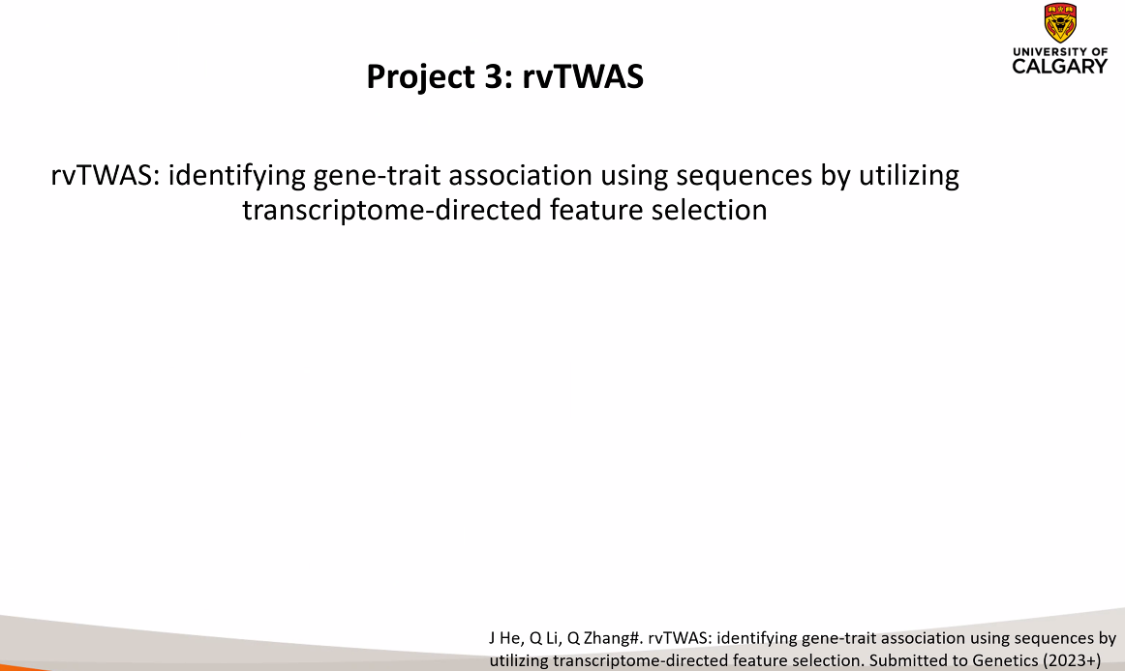
Project 3

Slide 29
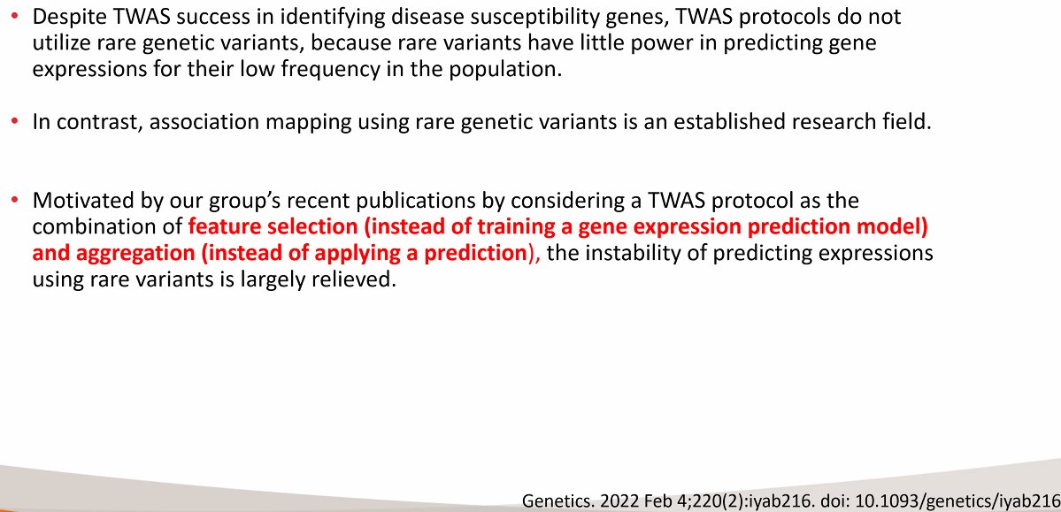

Slide 30
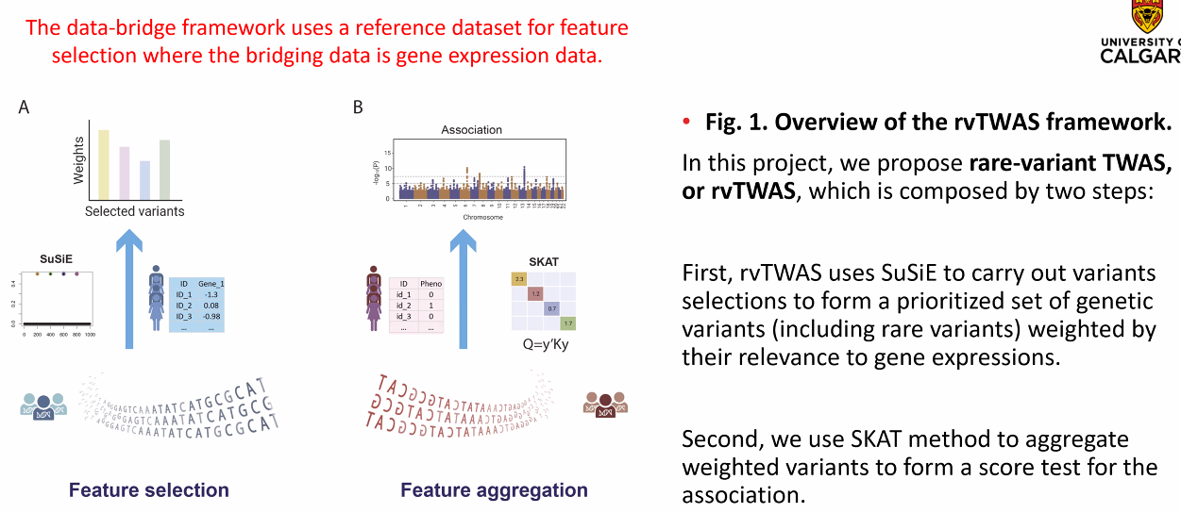

Slide 31
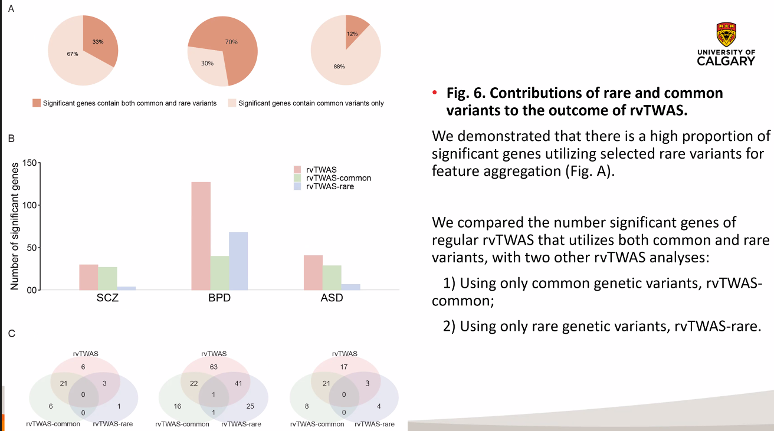

Slide 32
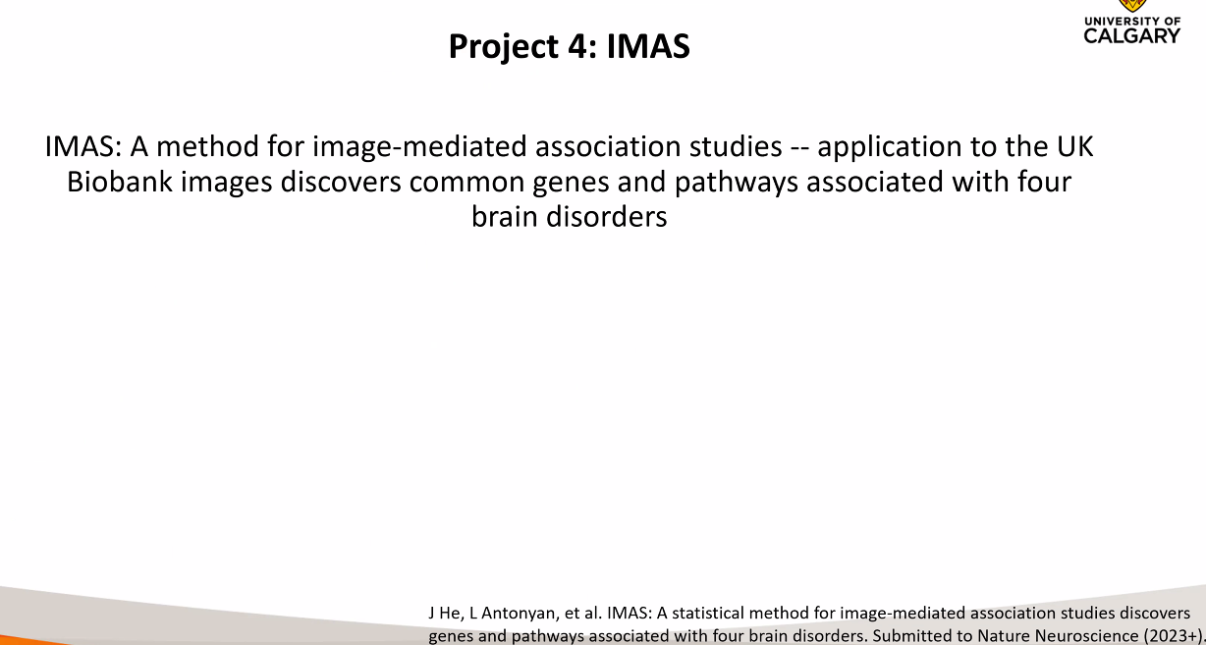
Project 4

Slide 33
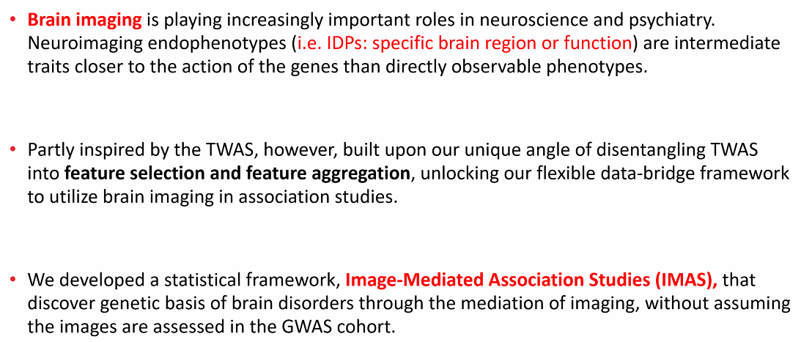

Slide 34
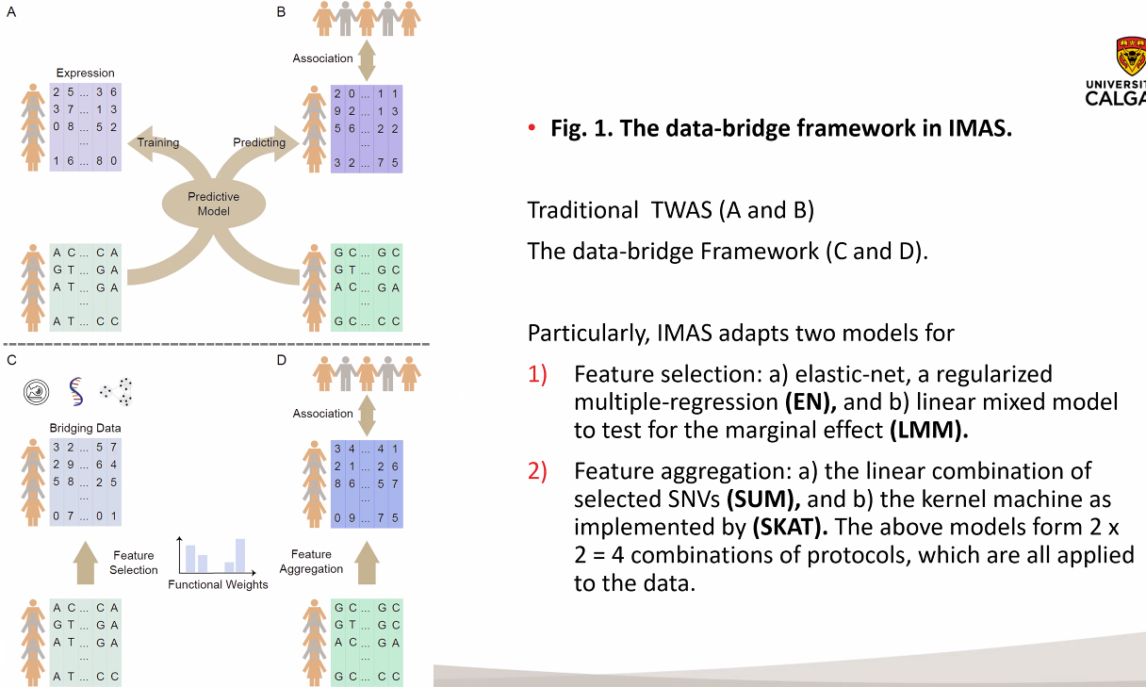

Slide 35
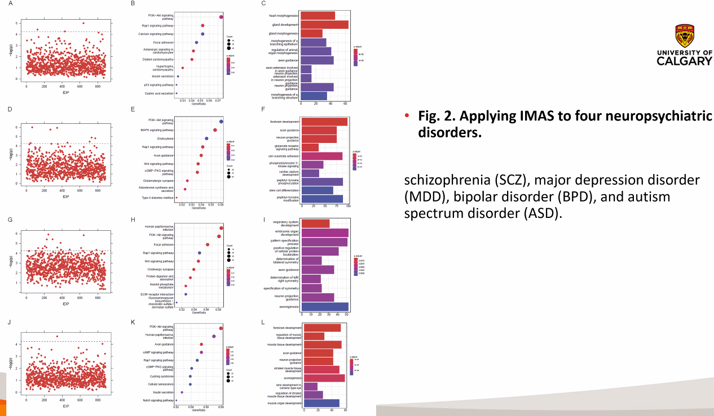

Slide 36
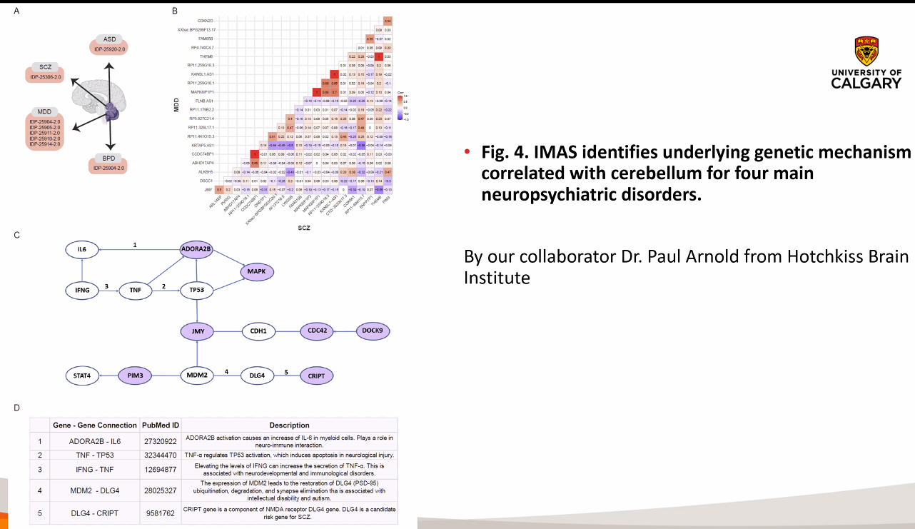

Slide 37
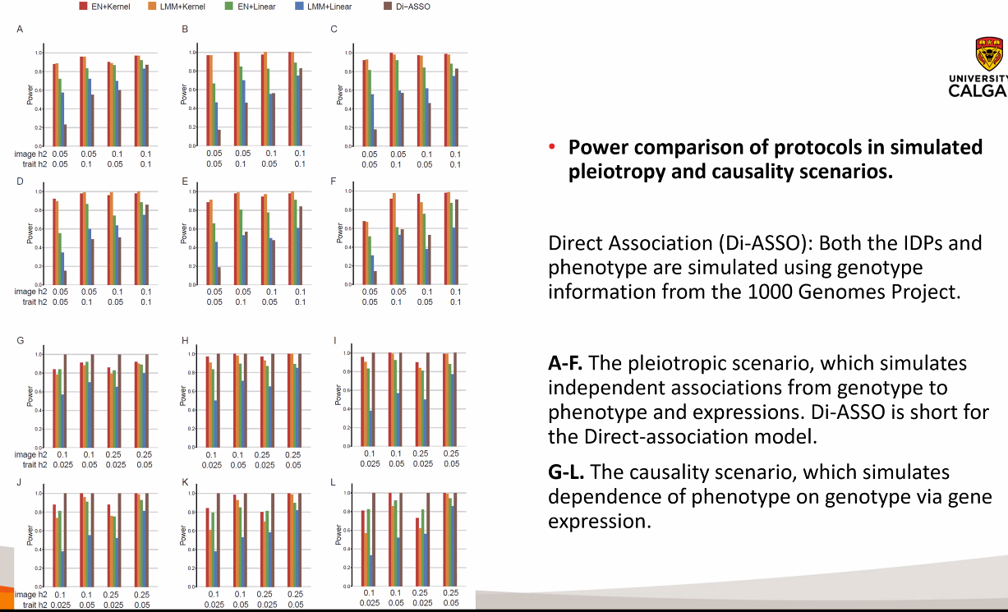

Slide 38
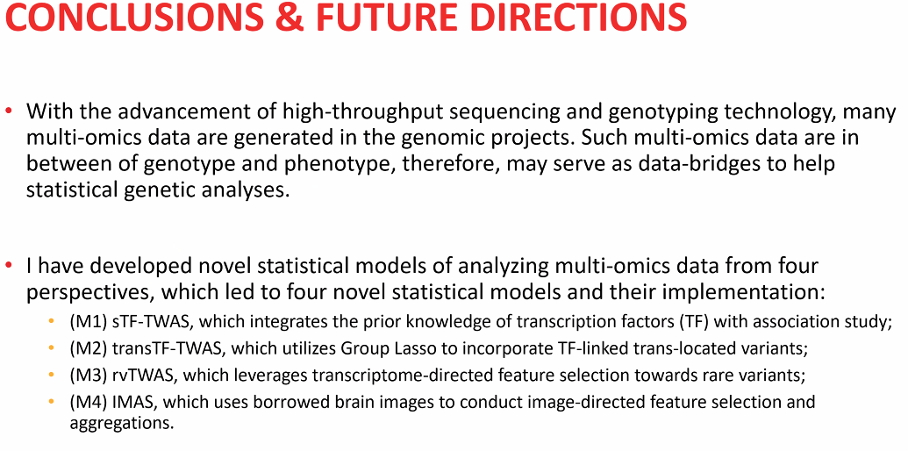

Slide 39
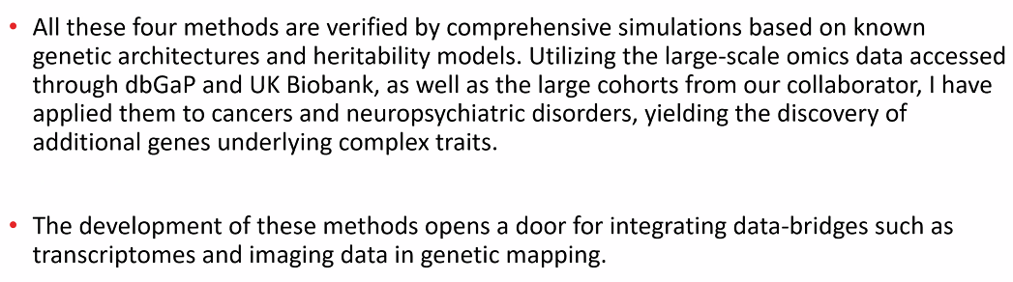

Slide 40
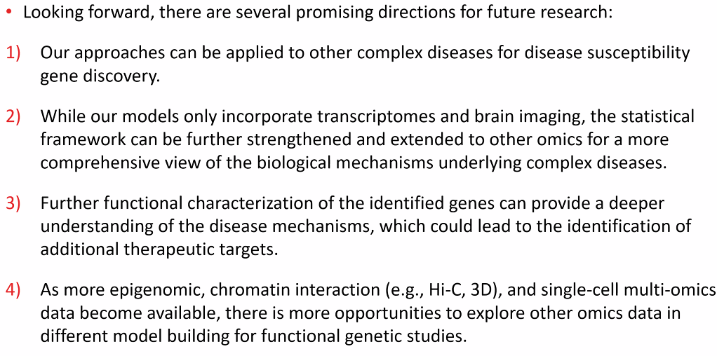

Slide 41
